Slide 1
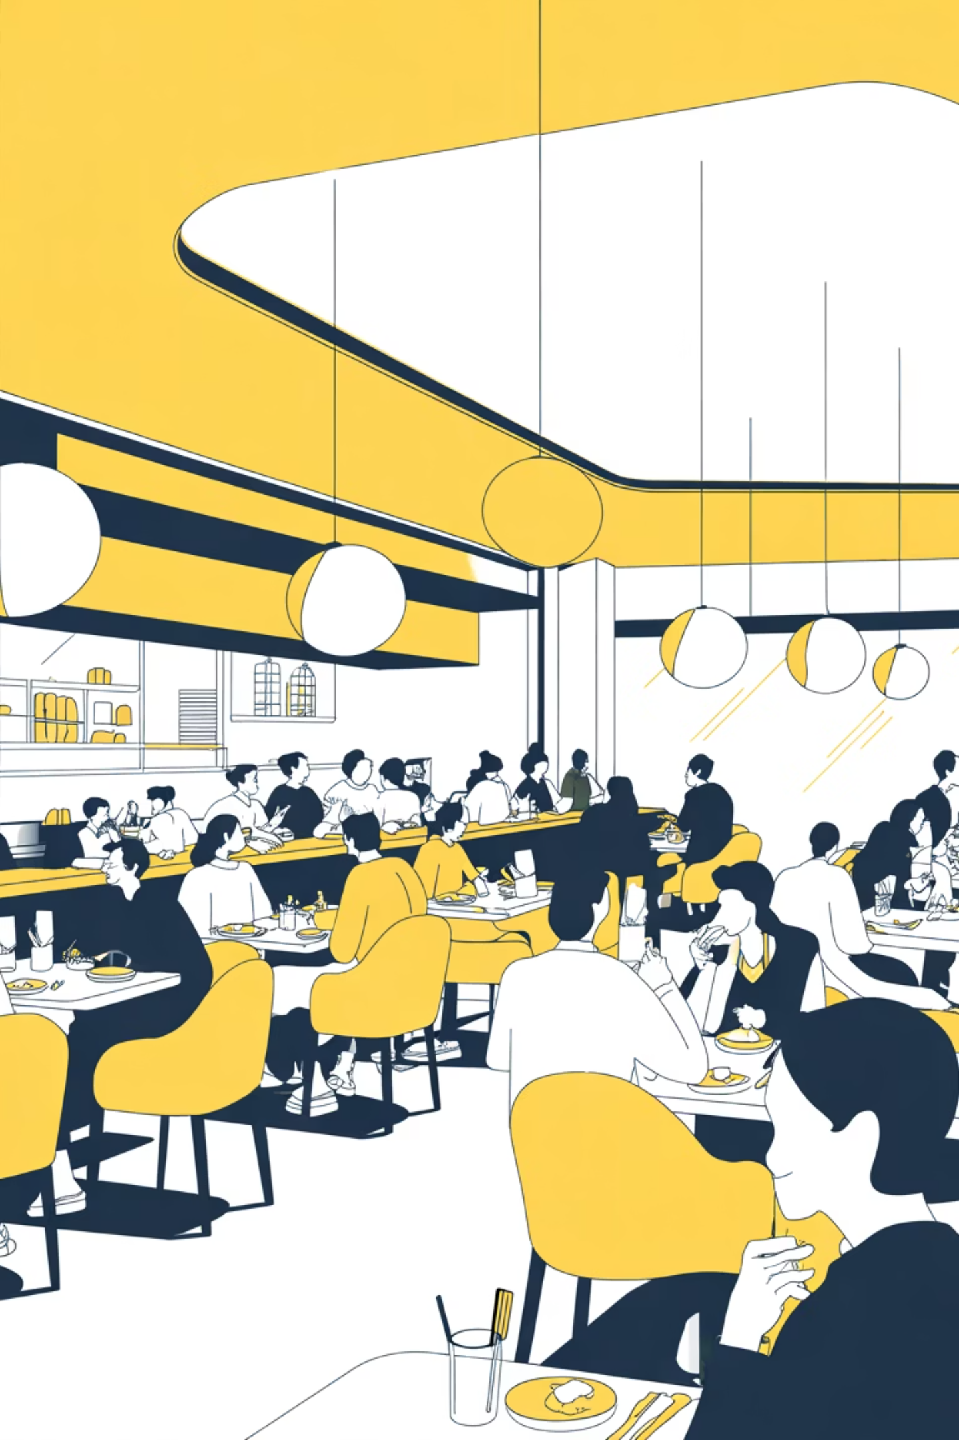
Restaurant Performance Analytics
A comprehensive look at sales recovery, pricing dynamics, customer growth, and strategic opportunities driving restaurant success.

Slide 2
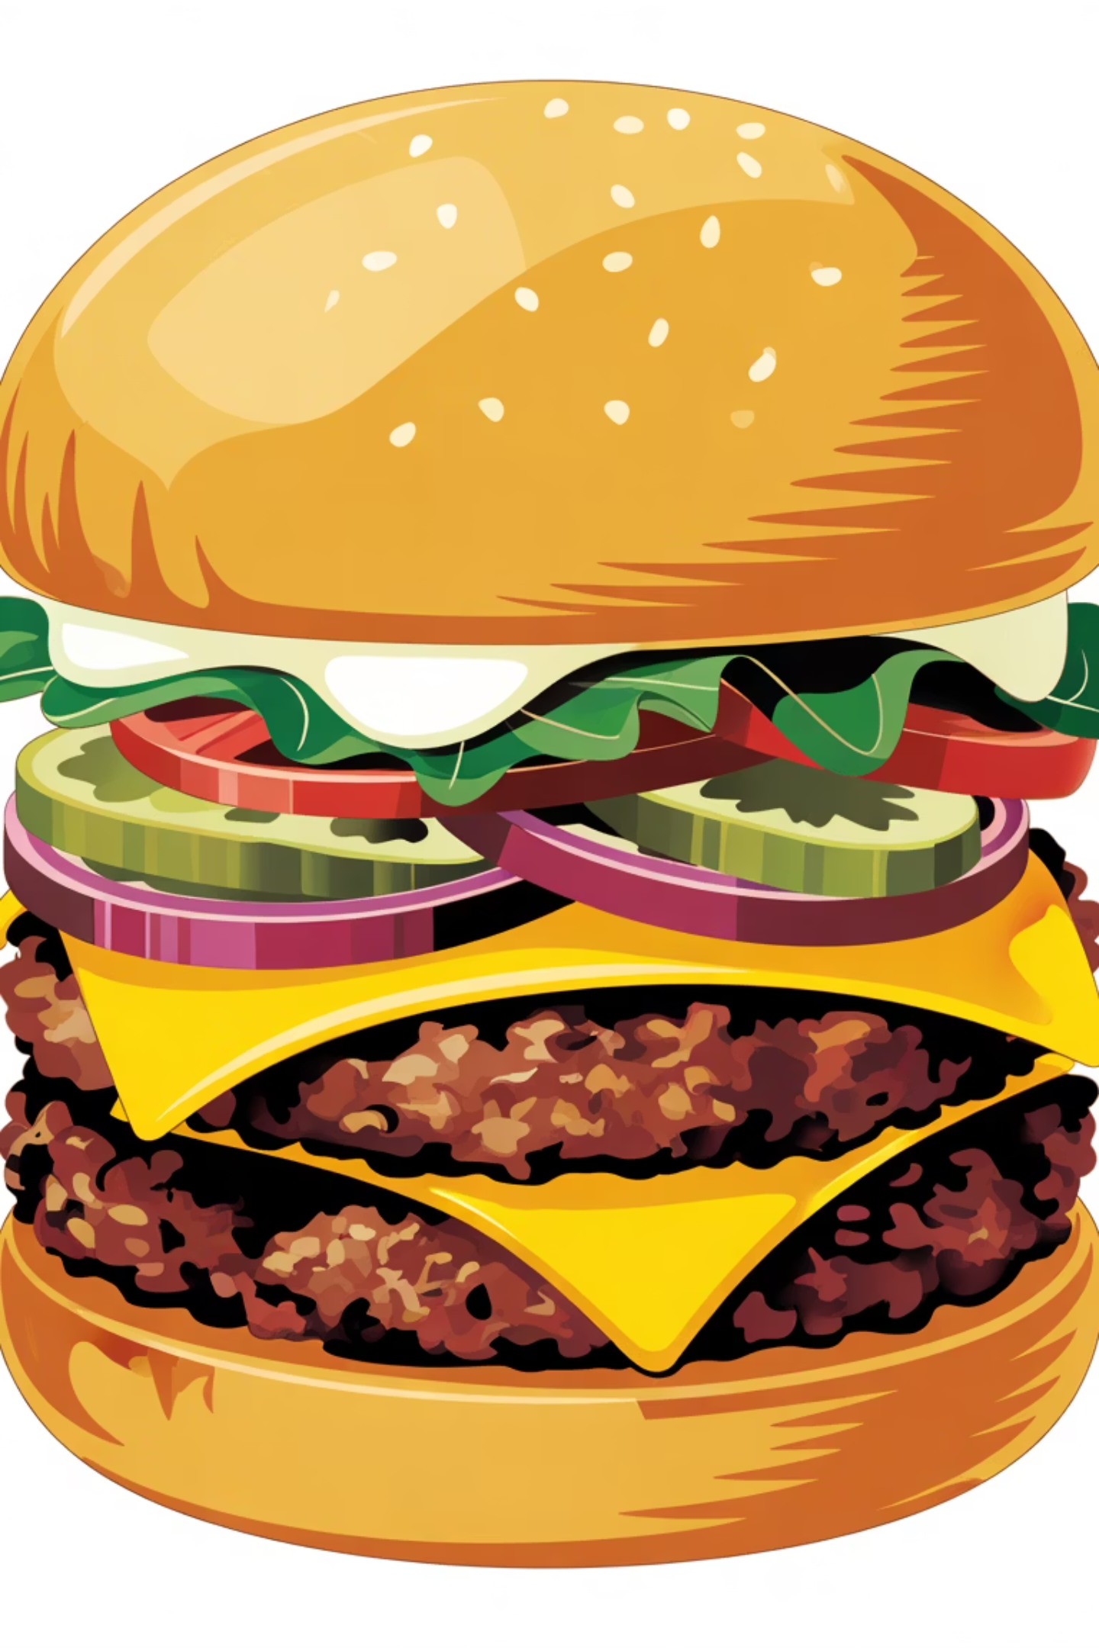
The Sales Comeback
Sales skyrocketed to $671,144, a +63.96% month-over-month surge. Lisbon led with $211,749, while Burgers dominated at $347,952 in revenue.
Total Sales
$671,144
Growth Rate
+63.96% MoM
Top City
Lisbon: $211,749
Top Product
Burgers: $347,952

Slide 3


Key Driver: In-Store Activity
Strong in-store engagement and credit card payments fueled growth. Customers prefer direct, convenient transactions over other channels.
In-Store Dominance
Primary sales driver with highest customer engagement.
Card Payments Lead
Credit card transactions show customer preference for convenience.
Strategic Opportunity
Expand in-store promotions in Lisbon and London.

Slide 4
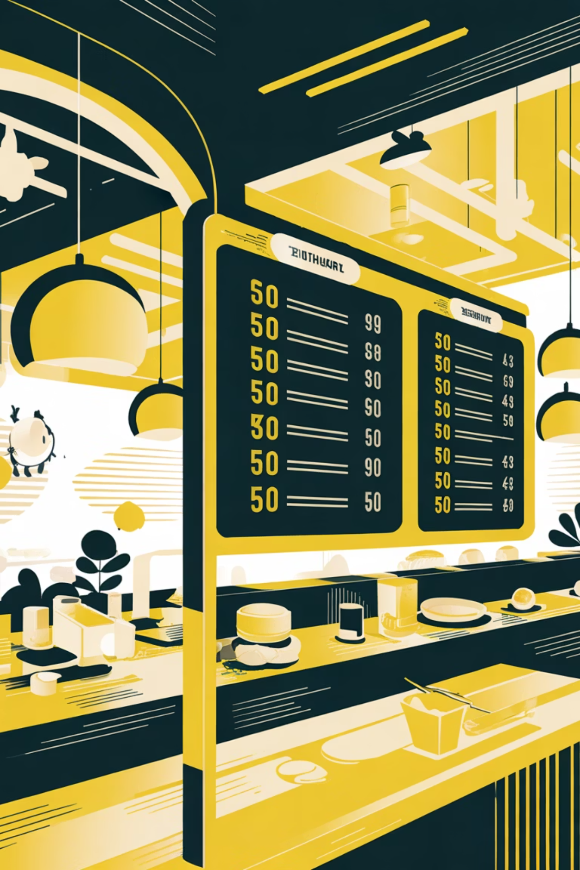
The Price Paradox
Average unit price dropped 1.95% to $6.23, yet orders surged 63.79%. Small price reductions drive significant volume increases through demand elasticity.
Price Change
Order Increase
-1.95% to $6.23
+63.79%

Slide 5
Pricing Strategy Recommendations
Maintain competitive pricing on high-demand items. Implement dynamic pricing during low-traffic periods and monitor product-level price elasticity to optimize revenue.
Competitive Pricing
Dynamic Models
Elasticity Monitoring
Keep Burgers and Fries prices attractive to maintain volume.
Offer discounts during low-traffic periods to sustain customer flow.
Track which products respond most to price changes.

Slide 6
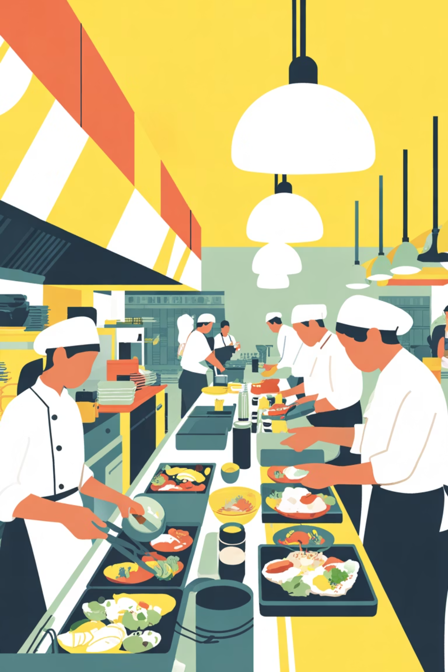
The Order Surge
Orders reached 116,882 with peak activity October-December. Beverages and Fries led volume, indicating strong impulse and add-on purchase behavior.
116,882
Oct-Dec
Total Orders
Peak Period
Significant seasonal spike
Festive season surge

Slide 7
Seasonal Opportunities
Consumer behavior peaks seasonally. Smaller-priced items drive volume. Bundle fast-moving products and forecast inventory using trend patterns to avoid stockouts.
01
02
03
Seasonal Campaigns
Strategic Bundling
Inventory Forecasting
Launch beverage/snack promotions during high-traffic months.
Combine Fries + Beverages to increase transaction value.
Use order trends to prevent stockouts during peak periods.

Slide 8



The Customer Comeback
Active customers grew 58.75% to 254 total. Lisbon and London each had 75 customers. In-store purchases dominated at 42%; credit cards led at 47%.
58.75%
42%
47%
Customer Growth
In-Store Preference
Card Payments

Slide 9
Customer Retention Strategy
Launch loyalty programs in Lisbon and London. Improve digital engagement in Paris and Berlin. Offer mobile payments and personalized discounts to boost online and drive-thru usage.
Loyalty Programs
Digital Engagement
Payment Options
Retain high-value customers in top cities.
Strengthen presence in underperforming markets.
Enable mobile payments and personalized offers.

Slide 10

Path Forward
Capitalize on momentum through targeted in-store promotions, strategic bundling, dynamic pricing, and loyalty programs. Focus on Lisbon and London while expanding digital reach in emerging markets.

